Slide 1
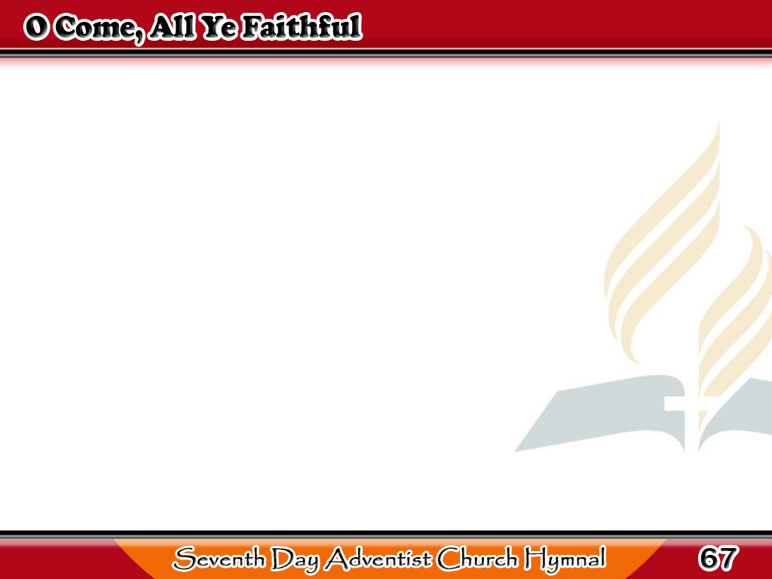
Kayong mga Tapat, Kayo’y Pumarito
O come all ye faithful,
joyful and triumphant,
O come ye, O come ye
to Bethlehem!
1/3

Slide 2
Kayong mga Tapat, Kayo’y Pumarito
Come and behold Him,
born the King of angels!
1/3

Slide 3
Kayong mga Tapat, Kayo’y Pumarito
-Refrain-
O come, let us adore Him,
O come, let us adore Him,
O come, let us adore Him,
Christ, the Lord!
1/3

Slide 4
Kayong mga Tapat, Kayo’y Pumarito
Sing, choirs of angels
sing in exultation,
O sing, all ye citizens
of heaven above! Glory to God,
all glory in the highest!
2/3

Slide 5
Kayong mga Tapat, Kayo’y Pumarito
-Refrain-
O come, let us adore Him,
O come, let us adore Him,
O come, let us adore Him,
Christ, the Lord!
2/3

Slide 6
Kayong mga Tapat, Kayo’y Pumarito
Yea, Lord, we greet Thee,
born this happy morning,
Jesus, to thee be all glory given;
Word of the Father,
now in flesh appearing!
3/3

Slide 7
Kayong mga Tapat, Kayo’y Pumarito
-Refrain-
O come, let us adore Him,
O come, let us adore Him,
O come, let us adore Him,
Christ, the Lord!
3/3

